Slide 1
Introduction to (Unconventional) Vectorization
Stefanos Baziotis
NEC Deutschland
National and Kapodistrian University of Athens
stefanos.baziotis@gmail.com

Slide 2
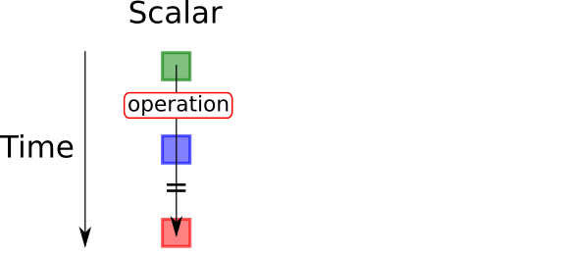
What is Vectorization ?

Slide 3
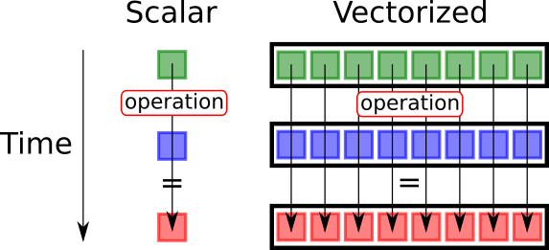
What is Vectorization ?

Slide 4
Vectorized Code in a High-Level Language
int add(int a, int b) {
return a + b;
}

Slide 5
Intrinsics
__m128i add4(__m128i a, __m128i b) {
return _mm_add_epi32(a, b);
}
Intel Intrinsics Guide

Slide 6
Vectorizing a Loop
void sum_arrays(int *A, int *B, int *C, int len) {
for (int i = 0; i < len; ++i)
C[i] = A[i] + B[i];
}

Slide 7
Vectorizing a Loop
void sum_arrays(int *A, int *B, int *C, int len) {
for (int i = 0; i < len; i += 4) {
v1 = load 4 values from A
v2 = load 4 values from B
res = 4-packed add(v1, v2)
store res (which is 4 values) in C
}
}
Notes:
High-level algorithm

Slide 8
Loading a Vector
_mm_loadu_si128((const __m128i*) m);

Slide 9
Loading a Vector
__m128i loadu_si128(void *m) {
return _mm_loadu_si128((const __m128i*) m);
}
Notes:
load does not need to interpret data in a specific way (like e.g. add). load only needs to bring bits from memory. Yet, there are exists tens of ways to load, each one requiring a different type of pointer to be passed in, resulting in ugly code full of casts. So, we wrap it in a function.

Slide 10
Vectorizing a Loop
void sum_arrays(int *A, int *B, int *C, int len) {
for (int i = 0; i < len; i += 4) {
__m128i v1 = loadu_si128(&A[i]);
__m128i v2 = loadu_si128(&B[i]);
__m128i res = add4(v1, v2);
storeu_si128(&C[i], res);
}
}

Slide 11
The Struggles of Vectorization

Slide 12
Vectorizing a Loop
void sum_arrays(int *A, int *B, int *C, int len) {
for (int i = 0; i < len; i += 4) {
__m128i v1 = loadu_si128(&A[i]);
__m128i v2 = loadu_si128(&B[i]);
__m128i res = add4(v1, v2);
storeu_si128(&C[i], res);
}
}
What if len is not a multiple of 4?

Slide 13
Vectorizing a Loop
void sum_arrays(int *A, int *B, int *C, int len) {
int end = (len % 4 == 0) ? len : len - 4;
for (int i = 0; i < end; i += 4) {
__m128i v1 = loadu_si128(&A[i]);
__m128i v2 = loadu_si128(&B[i]);
__m128i res = add4(v1, v2);
storeu_si128(&C[i], res);
}
}

Slide 14
Vectorizing a Loop
void sum_arrays(int *A, int *B, int *C, int len) {
int end = (len % 4 == 0) ? len : len - 4;
int i = 0;
for (; i < end; i += 4) {
__m128i v1 = loadu_si128(&A[i]);
__m128i v2 = loadu_si128(&B[i]);
__m128i res = add4(v1, v2);
storeu_si128(&C[i], res);
}
for (; i < len; ++i) {
C[i] = A[i] + B[i];
}
}

Slide 15
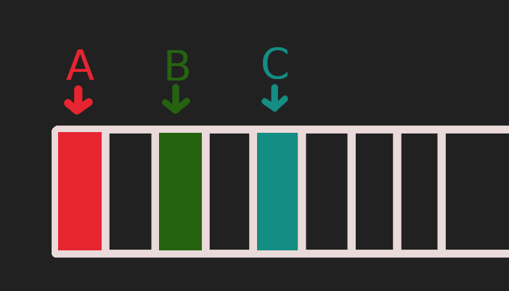
Aliasing

Slide 16
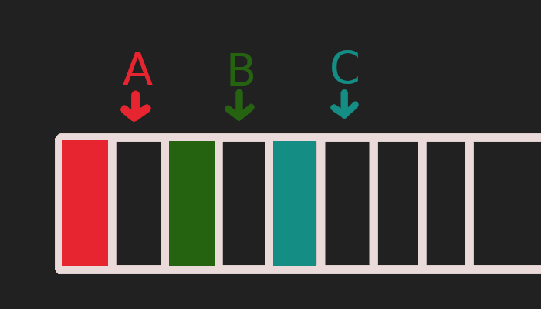
Aliasing

Slide 17
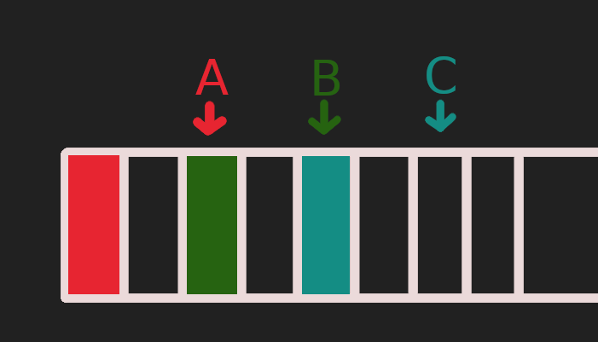
Aliasing
Notes:
Note that in this iteration, B loads from where C stored in the first iteration

Slide 18
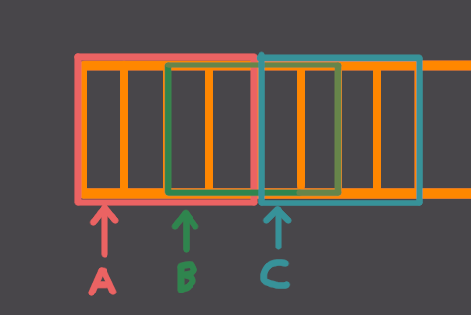
Aliasing

Slide 19
Aliasing
void sum_arrays(int *A, int *B, int *C, int len) {
if (A + len > Β)
jump to the scalar version
if (B + len > A)
jump to the scalar version
...
}

Slide 20
Aliasing
void sum_arrays(int *restrict A,
int *restrict B,
int *restrict C,
int len) {
...
}

Slide 21
Reductions

Slide 22
Reductions
new_value = operation(old_value, data);

Slide 23
Accumulation
int sum_of_array(int *a, int len) {
int sum = 0;
for (int i = 0; i < len; ++i)
sum = sum + a[i];
}

Slide 24
Accumulation
int sum_of_array(int *a, int len) {
int sum = 0;
for (int i = 0; i < len; ++i)
sum = sum + a[i];
}
new value

Slide 25
Accumulation
int sum_of_array(int *a, int len) {
int sum = 0;
for (int i = 0; i < len; ++i)
sum = sum + a[i];
}
new value
old value

Slide 26
Accumulation
int sum_of_array(int *a, int len) {
int sum = 0;
for (int i = 0; i < len; ++i)
sum = sum + a[i];
}
new value
old value
operation

Slide 27
Accumulation
int sum_of_array(int *a, int len) {
int sum = 0;
for (int i = 0; i < len; ++i)
sum = sum + a[i];
}
new value
data
old value
operation

Slide 28
Associativity and Commutativity
new_value = operation(old_value, data);

Slide 29
Associativity
(((1 + 2) + 3) + 4) = (1 + 2) + (3 + 4)

Slide 30
Associativity
(((1 + 2) + 3) + 4) = (1 + 2) + (3 + 4)
+

Slide 31
Associativity
(((1 + 2) + 3) + 4) = (1 + 2) + (3 + 4)
+
+

Slide 32
Associativity
(((1 + 2) + 3) + 4) = (1 + 2) + (3 + 4)
+
+
+

Slide 33
Associativity
(((1 + 2) + 3) + 4) = (1 + 2) + (3 + 4)
+
+
+
+

Slide 34
Associativity
(((1 + 2) + 3) + 4) = (1 + 2) + (3 + 4)
+
+
+
+
+

Slide 35
Associativity
(((1 + 2) + 3) + 4) = (1 + 2) + (3 + 4)
+
+
+
+
+
+
Notes:
In the left, there is a recurrence, so we have to execute sequentially. On the right, we can launch two threads in parallel for the partial sums.

Slide 36
Commutativity
1 + 2 + 3 + 4 + 5 + 6 + 7 + 8

Slide 37
Commutativity
1 + 2 + 3 + 4 + 5 + 6 + 7 + 8

Slide 38
Commutativity
1 + 2 + 3 + 4 + 5 + 6 + 7 + 8

Slide 39
Associativity
1 + 2 + 3 + 4 + 5 + 6 + 7 + 8

Slide 40
Commutativity
1 + 2 + 3 + 4 + 5 + 6 + 7 + 8
Notes:
Observation that we can also do the sums like that

Slide 41
Loading from Memory
1 + 2 + 3 + 4 + 5 + 6 + 7 + 8
Notes:
If they’re stored in memory in this order, the first 4 are going to go on one vector, the next 4 on the other

Slide 42
Loading from Memory
1 | 2 | 3 | 4
+
5 | 6 | 7 | 8
Notes:
It matches the previous way we did partial additions

Slide 43
Vectorizing Summanation
int sum_of_array(int *A, int len) {
int end = (len % 4 == 0) ? len : len - 4;
int i = ;
__m128i acc = // Register with all lanes equal to 0;
for (int i = 0; i < end; i += 4) {
__m128i v = loadu_si128(&A[i]);
acc = add4(v);
}
int final_result = add_all_lanes_epi32(acc);
for (; i < len; ++i) {
final_result += a[i];
}
return final_result;
}

Slide 44
Horizontal Add
int get_low_32_bits_si128(__m128i v) {
return _mm_cvtsi128_si32(v);
}
int add_all_lanes_epi32(__m128i v) {
v = _mm_hadd_epi32(v, v);
v = _mm_hadd_epi32(v, v);
return get_low_32_bits_si128(v);
}

Slide 45
Vectorizing Conditional Code

Slide 46
Invariant Condition
int a[VECTOR_WIDTH];
int b[VECTOR_WIDTH];
int out[VECTOR_WIDTH];
...
if (c) {
for (int i = 0; i < VECTOR_WIDTH; ++i)
out[i] = a[i] + b[i];
}
Notes:
If the condition is invariant, so if it impacts either all lanes or none, vectorization is trivial (and the condition can remain scalar).

Slide 47
Invariant Condition
__m128i a_vector = _mm_loadu_si128(&a[0]);
__m128i b_vector = _mm_loadu_si128(&b[0]);
if (c) {
__m128i res = add4(a_vector, b_vector)
_mm_storeu_si128(&out[0], res);
}

Slide 48
Divergent Condition
int a[VECTOR_WIDTH];
int b[VECTOR_WIDTH];
int out[VECTOR_WIDTH];
...
for (int i = 0; i < VECTOR_WIDTH; ++i) {
if (c[i]) {
out[i] = a[i] + b[i];
}
}

Slide 49
Divergent Condition
int a[VECTOR_WIDTH];
int b[VECTOR_WIDTH];
int out[VECTOR_WIDTH];
...
for (int i = 0; i < VECTOR_WIDTH; ++i) {
if (c[i]) {
out[i] = a[i] + b[i];
}
}
Divergent!

Slide 50
Generic Form
for (int i = 0; i < VECTOR_WIDTH; ++i) {
if (cond[i]) { // Divergent condition
value[i] = some computation;
} else {
value[i] = some other computation;
}
}
Notes:
We’ll describe a generic way to handle this form.

Slide 51
Predication
for (int i = 0; i < VECTOR_WIDTH; ++i) {
a[i] = some computation;
}
for (int i = 0; i < VECTOR_WIDTH; ++i) {
b[i] = some other computation;
}

Slide 52
Predication
for (int i = 0; i < VECTOR_WIDTH; ++i) {
a[i] = some computation;
}
for (int i = 0; i < VECTOR_WIDTH; ++i) {
b[i] = some other computation;
}
for (int i = 0; i < VECTOR_WIDTH; ++i) {
if (cond[i]) { // Divergent condition
value[i] = a[i];
} else {
value[i] = b[i];
}
}

Slide 53
Predication
for (int i = 0; i < VECTOR_WIDTH; ++i) {
a[i] = some computation;
}
for (int i = 0; i < VECTOR_WIDTH; ++i) {
b[i] = some other computation;
}
for (int i = 0; i < VECTOR_WIDTH; ++i) {
if (cond[i]) { // Divergent condition
value[i] = a[i];
} else {
value[i] = b[i];
}
}
1 instruction

Slide 54
Predication
for (int i = 0; i < VECTOR_WIDTH; ++i) {
a[i] = some computation;
}
for (int i = 0; i < VECTOR_WIDTH; ++i) {
b[i] = some other computation;
}
for (int i = 0; i < VECTOR_WIDTH; ++i) {
if (cond[i]) { // Divergent condition
value[i] = a[i];
} else {
value[i] = b[i];
}
}
1 instruction
1 instruction

Slide 55
Predication
for (int i = 0; i < VECTOR_WIDTH; ++i) {
a[i] = some computation;
}
for (int i = 0; i < VECTOR_WIDTH; ++i) {
b[i] = some other computation;
}
for (int i = 0; i < VECTOR_WIDTH; ++i) {
if (cond[i]) { // Divergent condition
value[i] = a[i];
} else {
value[i] = b[i];
}
}
1 instruction
1 instruction
1 instruction!!

Slide 56
Outer-Loop Vectorization
Simon Moll et al.
Nuzman, Zaks

Slide 57
Outer-Loop Vectorization
for (int i = 0; i < n; ++i) {
int a = 0;
for (int j = 0; j < m; ++j) {
int v = A[j*m + i];
a += v;
}
B[i] = a;
}

Slide 58
Iteration Space
------------- m -------------
|
|
|
|
n
|
|
|
|
|
A
B

Slide 59
Iteration Space
------------- m -------------
|
|
|
|
n
|
|
|
|
|
A
B

Slide 60
Iteration Space
------------- m -------------
|
|
|
|
n
|
|
|
|
|
+
miss!
A
B

Slide 61
Iteration Space
------------- m -------------
|
|
|
|
n
|
|
|
|
|
+
miss!
+
A
miss!
B

Slide 62
Iteration Space
------------- m -------------
|
|
|
|
n
|
|
|
|
|
+
miss!
+
A
miss!
+
miss!
B

Slide 63
Iteration Space
------------- m -------------
|
|
|
|
n
|
|
|
|
|
+
miss!
+
A
miss!
+
miss!
+
miss!
B

Slide 64
Iteration Space
------------- m -------------
|
|
|
|
n
|
|
|
|
|
A
Store sum
B

Slide 65
Iteration Space
------------- m -------------
|
|
|
|
n
|
|
|
|
|
A
B

Slide 66
Loop Interchange?
… zero B;
for (int j = 0; j < m; ++j) {
for (int i = 0; i < n; ++i) {
int v = A[j*m + i];
B[i] += v;
}
}
Notes:
I note that interchange is not trivial for the compiler, because B had to be moved inside the loop and the array to be zeroed before starting. Also, now we have one store per iteration, which is bad since modern CPUs have one port for stores.

Slide 67
Iteration Space
------------- m -------------
|
|
|
|
n
|
|
|
|
|
A
B

Slide 68
Iteration Space
------------- m -------------
|
|
|
|
n
|
|
|
|
|
A
B

Slide 69
Iteration Space
------------- m -------------
|
|
|
|
n
|
|
|
|
|
A
Add value
B

Slide 70
Iteration Space
------------- m -------------
|
|
|
|
n
|
|
|
|
|
A
B

Slide 71
Iteration Space
------------- m -------------
|
|
|
|
n
|
|
|
|
|
A
B

Slide 72
Iteration Space
------------- m -------------
|
|
|
|
n
|
|
|
|
|
A
B

Slide 73
Iteration Space
------------- m -------------
|
|
|
|
n
|
|
|
|
|
A
B

Slide 74
Outer-Loop Vectorization
for (int i = 0; i < n; ++i) {
int a = 0;
for (int j = 0; j < m; ++j) {
int v = A[j*m + i];
a += v;
}
B[i] = a;
}

Slide 75
Outer-Loop Vectorization
for (int i = 0; i < end; i += 4) {
__m128i a = [0,0,0,0];
for (int j = 0; j < m; ++j) {
__m128i v = loadu_si128(A[j*m + i]);
a = add4(a, v);
}
storeu_si128(&B[i], a);
}
… residual

Slide 76
Iteration Space
------------- m -------------
|
|
|
|
n
|
|
|
|
|
A
B

Slide 77
Iteration Space
------------- m -------------
|
|
|
|
n
|
|
|
|
|
A
B

Slide 78
Iteration Space
------------- m -------------
|
|
|
|
n
|
|
|
|
|
+
+
+
+
miss!
A
B

Slide 79
Iteration Space
------------- m -------------
|
|
|
|
n
|
|
|
|
|
+
+
+
+
miss!
+
+
+
+
A
miss!
B

Slide 80
Iteration Space
------------- m -------------
|
|
|
|
n
|
|
|
|
|
+
+
+
+
miss!
+
+
+
+
A
miss!
+
+
+
+
miss!
B

Slide 81
Iteration Space
------------- m -------------
|
|
|
|
n
|
|
|
|
|
+
+
+
+
miss!
+
+
+
+
A
miss!
+
+
+
+
miss!
+
+
+
+
miss!
B

Slide 82
Iteration Space
------------- m -------------
|
|
|
|
n
|
|
|
|
|
+
+
+
+
miss!
+
+
+
+
A
miss!
+
+
+
+
miss!
+
+
+
+
miss!
Store sum
B

Slide 83
Conditional Code
for (int i = 0; i < n; ++i) {
int a = 0;
for (int j = 0; j < m; ++j) {
bool p = C[j];
if (p) {
int v = A[j*m + i];
a += v;
}
}
B[i] = a;
}

Slide 84
Uniformity
A uniform value is characterized in relationto a loop and is one that does not vary because of this loop.

Slide 85
Divergence
Divergent = !Uniform

Slide 86
Uniformity in Innermost Loops
for (int i = 0; i < N; ++i) {
int v = 1 + 2;
a[i] = v;
}

Slide 87
Uniformity in Innermost Loops
for (int i = 0; i < N; ++i) {
int v = 1 + 2;
a[i] = v;
}
v is uniform and also loop-invariant

Slide 88
Hoist Out
int v = 1 + 2;
for (int i = 0; i < N; ++i) {
a[i] = v;
}

Slide 89
Conditional Code
for (int i = 0; i < n; ++i) {
int a = 0;
for (int j = 0; j < m; ++j) {
bool p = C[j];
if (p) {
int v = A[j*m + i];
a += v;
}
}
B[i] = a;
}

Slide 90
Conditional Code
for (int i = 0; i < n; ++i) {
int a = 0;
for (int j = 0; j < m; ++j) {
bool p = C[j];
if (p) {
int v = A[j*m + i];
a += v;
}
}
B[i] = a;
}
What is p in the i-loop?

Slide 91

Conditional Code
for (int i = 0; i < n; ++i) {
int a = 0;
for (int j = 0; j < m; ++j) {
bool p = C[j];
if (p) {
int v = A[j*m + i];
a += v;
}
}
B[i] = a;
}
Uniform?
What is p in the i-loop?

Slide 92

Conditional Code
for (int i = 0; i < n; ++i) {
int a = 0;
for (int j = 0; j < m; ++j) {
bool p = C[j];
if (p) {
int v = A[j*m + i];
a += v;
}
}
B[i] = a;
}
Uniform?
What is p in the i-loop?
Loop-Invariant?

Slide 93
Uniformity Enables Outer-Loop Vectorization
for (int i = 0; i < end; i += 4) { // vectorized
__m128i a = [0,0,0,0];
for (int j = 0; j < m; ++j) {
bool p = C[j];
if (p) {
__m128i v = loadu_si128(A[j*m + i]);
a = add4(a, v);
}
}
storeu_si128(&B[i], a);
}
… residual
Notes:
Vectorization in the presence of uniform conditions is trivial and very efficient. The if remains scalar.

Slide 94
Recursive Tree Traversal Vectorization
Milind Kulkarni et al.

Slide 95
Tree
1
2
3
4
5
6
7
8
9
10
11
12
13
14
15

Slide 96
Tree
1
2
3
4
5
6
7
8
9
10
11
12
13
14
15
Nodes
1 2 4 8 9 5 10 11 3 6 12 13 7 14 15
A
Traversals
B
C
D

Slide 97
Tree
1
2
3
4
5
6
7
8
9
10
11
12
13
14
15
Nodes
1 2 4 8 9 5 10 11 3 6 12 13 7 14 15
A
Traversals
B
C
D

Slide 98
Tree
1
2
3
4
5
6
7
8
9
10
11
12
13
14
15
Nodes
1 2 4 8 9 5 10 11 3 6 12 13 7 14 15
A
Traversals
B
C
D

Slide 99
Tree
1
2
3
4
5
6
7
8
9
10
11
12
13
14
15
Nodes
1 2 4 8 9 5 10 11 3 6 12 13 7 14 15
A
Traversals
B
C
D

Slide 100
Tree
1
2
3
4
5
6
7
8
9
10
11
12
13
14
15
Nodes
1 2 4 8 9 5 10 11 3 6 12 13 7 14 15
A
Traversals
B
C
D

Slide 101
Tree
1
2
3
4
5
6
7
8
9
10
11
12
13
14
15
Nodes
1 2 4 8 9 5 10 11 3 6 12 13 7 14 15
A
Traversals
B
C
D

Slide 102
Tree
1
2
3
4
5
6
7
8
9
10
11
12
13
14
15
Nodes
1 2 4 8 9 5 10 11 3 6 12 13 7 14 15
A
Traversals
B
C
D

Slide 103
Tree
1
2
3
4
5
6
7
8
9
10
11
12
13
14
15
Nodes
1 2 4 8 9 5 10 11 3 6 12 13 7 14 15
A
Traversals
B
C
D

Slide 104
Tree
1
2
3
4
5
6
7
8
9
10
11
12
13
14
15
Nodes
1 2 4 8 9 5 10 11 3 6 12 13 7 14 15
A
Traversals
B
C
D

Slide 105
Tree
1
2
3
4
5
6
7
8
9
10
11
12
13
14
15
Nodes
1 2 4 8 9 5 10 11 3 6 12 13 7 14 15
A
Traversals
B
C
D

Slide 106
Tree
1
2
3
4
5
6
7
8
9
10
11
12
13
14
15
Nodes
1 2 4 8 9 5 10 11 3 6 12 13 7 14 15
A
Traversals
B
C
D

Slide 107
Tree
1
2
3
4
5
6
7
8
9
10
11
12
13
14
15
Nodes
1 2 4 8 9 5 10 11 3 6 12 13 7 14 15
A
Traversals
B
C
D

Slide 108
Tree
1
2
3
4
5
6
7
8
9
10
11
12
13
14
15
Nodes
1 2 4 8 9 5 10 11 3 6 12 13 7 14 15
A
Traversals
B
C
D

Slide 109
Tree
1
2
3
4
5
6
7
8
9
10
11
12
13
14
15
Nodes
1 2 4 8 9 5 10 11 3 6 12 13 7 14 15
A
Traversals
B
C
D

Slide 110
Tree
1
2
3
4
5
6
7
8
9
10
11
12
13
14
15
Nodes
1 2 4 8 9 5 10 11 3 6 12 13 7 14 15
A
Traversals
B
C
D

Slide 111
Tree
1
2
3
4
5
6
7
8
9
10
11
12
13
14
15
Nodes
1 2 4 8 9 5 10 11 3 6 12 13 7 14 15
A
Traversals
B
C
D

Slide 112
Tree
1
2
3
4
5
6
7
8
9
10
11
12
13
14
15
Nodes
1 2 4 8 9 5 10 11 3 6 12 13 7 14 15
A
C
Traversals
B
D

Slide 113
Tree
1
2
3
4
5
6
7
8
9
10
11
12
13
14
15
Nodes
1 2 4 8 9 5 10 11 3 6 12 13 7 14 15
A
C
Traversals
B
D

Slide 114
Tree
1
2
3
4
5
6
7
8
9
10
11
12
13
14
15
Nodes
1 2 4 8 9 5 10 11 3 6 12 13 7 14 15
A
C
Traversals
B
D

Slide 115
Tree
1
2
3
4
5
6
7
8
9
10
11
12
13
14
15
Nodes
1 2 4 8 9 5 10 11 3 6 12 13 7 14 15
A
C
Traversals
B
D

Slide 116
Thank You!

